Slide 1

What Makes Little Willows Daycare Different ?

Slide 2

Location
We are Close to the major highways, I-49, 150, and 435.
Notes:
NOTE: To change images on this slide, select a picture and delete it. Then click the Insert Picture icon in the placeholder to insert your own image.

Slide 3
Communication
Daily Communication in real time through Procare.

Slide 4
Curriculum
Funshine Curriculum which involves, Math, Science, Social Studies and Reading, sign language, and Spanish

Slide 5
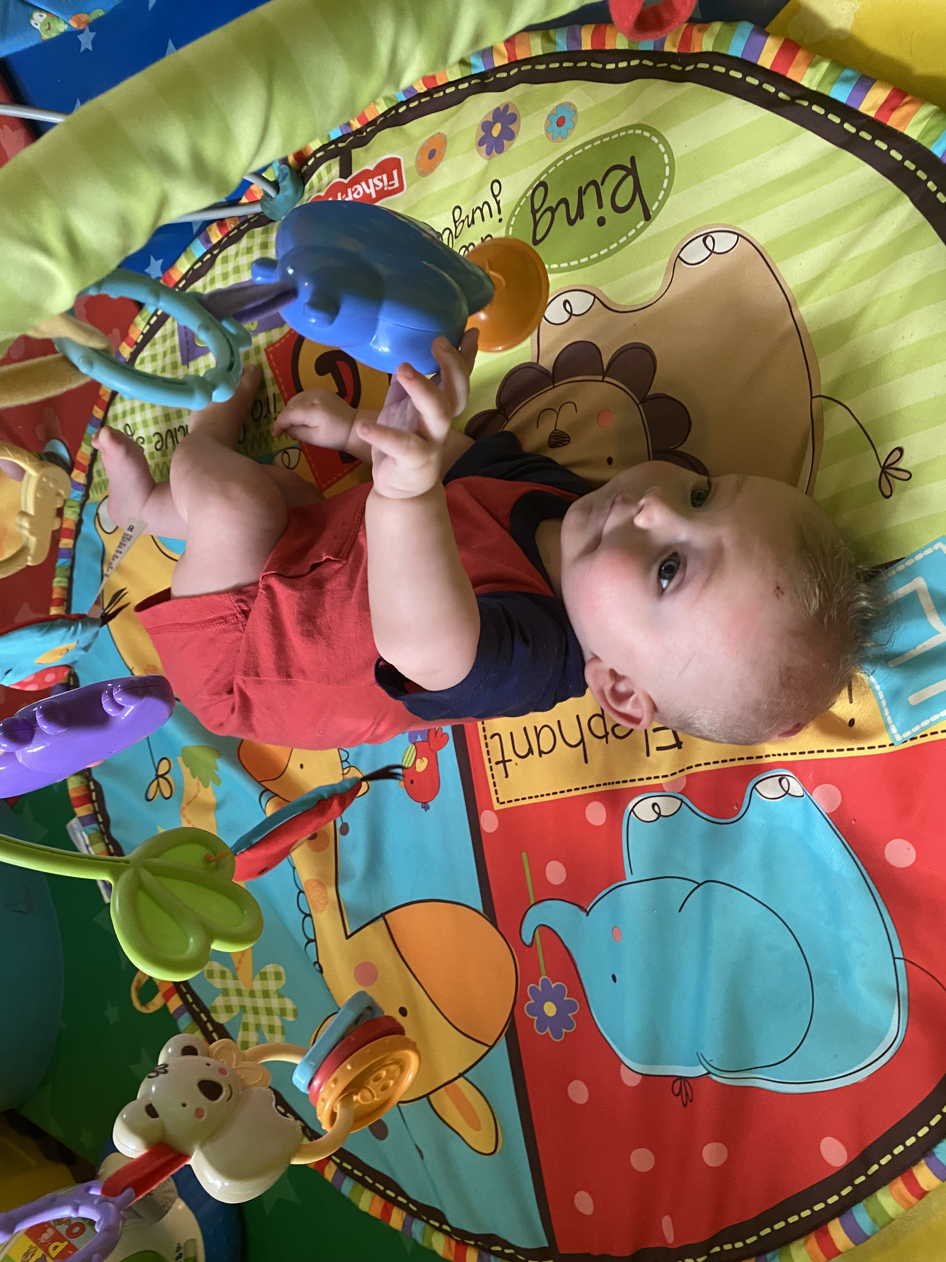
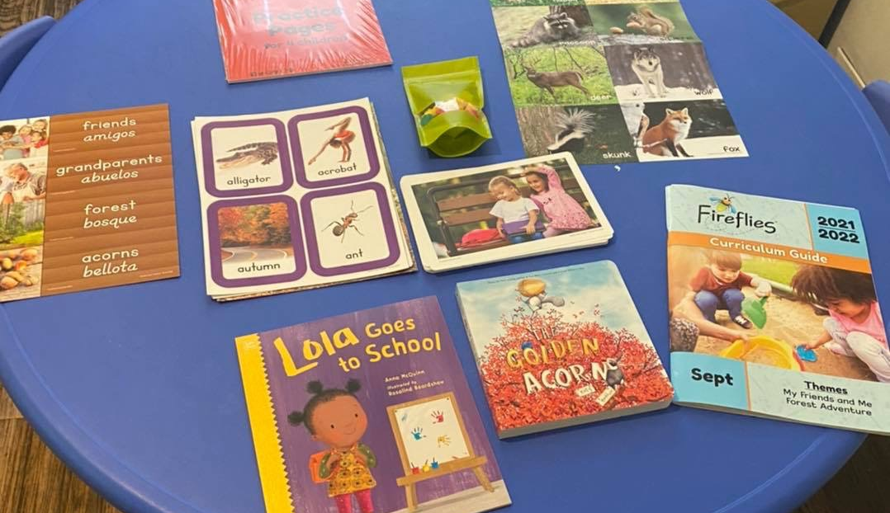

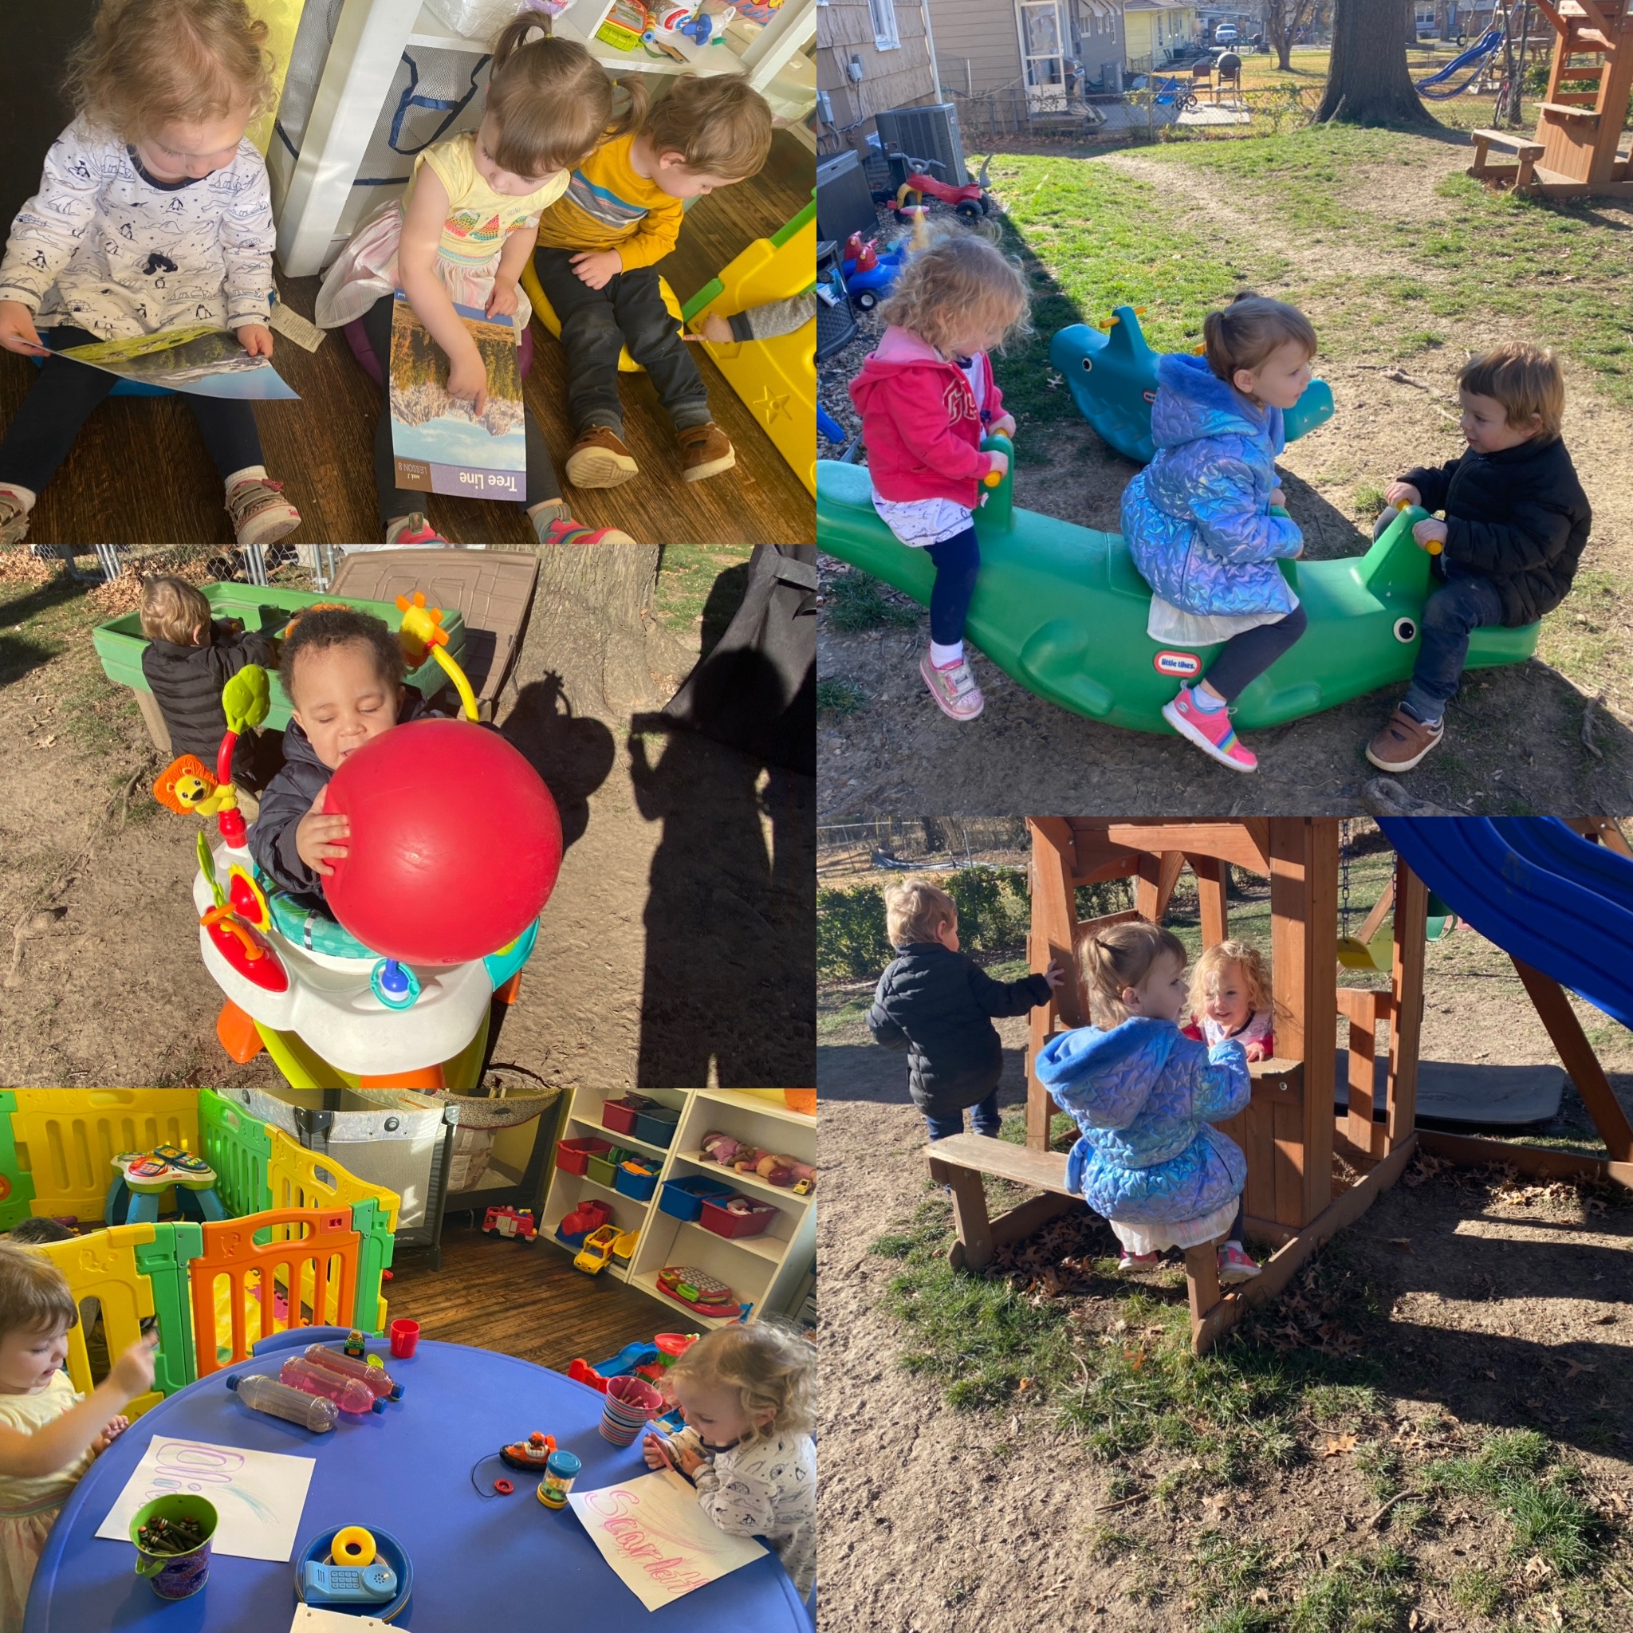

Daily Activities
Notes:
NOTE: To change images on this slide, select a picture and delete it. Then click the Insert Picture icon in the placeholder to insert your own image.

